Slide 1
Section-2 Descriptive Versus Explanatory Analysis
Key Performance Indicators and Visualizations

Slide 2
Key Performance Indicators and Visualizations
When running marketing campaigns or any other marketing efforts, you would most likely want to know how well each of them performs and understand the weaknesses and strengths of each of your marketing efforts.
Commonly used key performance indicators (KPIs) that help you track the performances of your marketing efforts.
More specifically, such KPIs as sales revenue, cost per acquisition (CPA), digital marketing KPIs, and site traffic.
We will learn how these KPIs can help you stay on track toward your marketing goals.
After discussing some of the commonly used KPIs, we will then learn how we can use Python and/or R to compute such KPIs and build visualizations of those KPIs.

Slide 3
Key Performance Indicators and Visualizations
Use a bank marketing dataset that showcases a real-world case of marketing campaigns for finance organizations.
For the Python project, we will learn how we can use the pandas and matplotlib libraries to analyze data and build visualizations.
For the R project, we will introduce the dplyr and ggplot2 libraries to analyze and manipulate data and build visualizations.
In particular, we will cover the following topics in this chapter:
KPIs to measure the performances of different marketing efforts
Computing and visualizing KPIs using Python
Computing and visualizing KPIs using R

Slide 4
KPIs to measure performances of different marketing efforts
Every marketing effort costs money to the company.
When you run marketing campaigns through emails, sending each email costs some money.
When you are running marketing efforts on social network services or broadcast media, it also requires some capital.
As every marketing effort is associated with some costs, it is critical to look at the performances of marketing campaigns and track the return on investments (ROI) of your marketing campaigns.
We will mainly discuss how to track sales revenue, CPA, and digital marketing KPIs in this section.

Slide 5
Sales revenue
It is clear that the goal of every marketing effort is to generate and grow more revenue for the company.
No company wants to spend more money on marketing than it generates.
In order to correctly report the sales revenue, you will need to clearly define how you want to attribute sales to each of your marketing efforts.
Some sales might come from email marketing campaigns, while others might come from advertisements placed on TV or public transportation.
Some sales could even come naturally, without any attributions to any of your marketing campaigns.
In order to correctly report how much sales revenue each of your marketing efforts drives, you will have to clearly define the rules.
For example, if you are an e-commerce company, promoting special offers through email and TV marketing campaigns, you might want to put a different URL in the emails than the URL in your TV commercials.
This way, you can identify and differentiate those sales from email marketing campaigns from those sales from marketing efforts through TV.

Slide 6
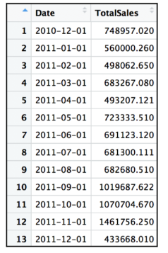
Sales revenue
Depending on your needs, you might also want to report time-series sales revenue data.
You can report it in a spreadsheet format, such as the following:

Slide 7
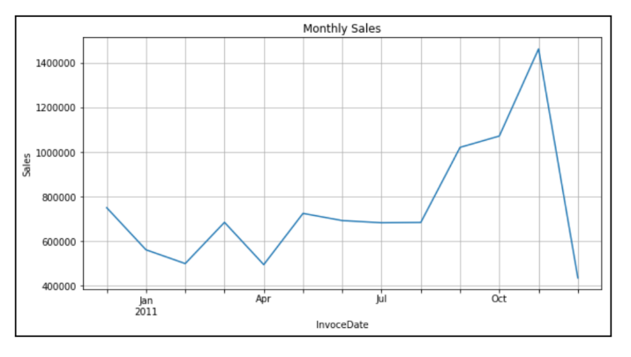
Sales revenue
Also report time-series sales revenue data in the line chart as follows:

Slide 8
Cost per acquisition (CPA)
Another way to look at the effectiveness of your marketing efforts is CPA.
This KPI metric tells you how much it costs you to acquire a customer through your marketing efforts.
A high CPA means it costs more to acquire a new customer, while a low CPA clearly means it costs less to acquire a new customer.
Depending on the type of business, you can still have a very profitable marketing campaign with a high CPA.
For example, if you are selling a very luxurious and high-end product, where the pool of targeted customers is small and it costs more to acquire such customers, your CPA might be high, but the value of each customer you acquired might be even higher and result in a profitable marketing campaign.

Slide 9
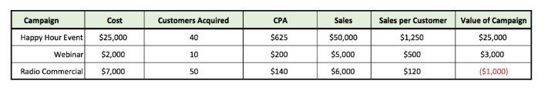
Cost per acquisition (CPA)
Hypothetical case:

Slide 10
Cost per acquisition (CPA)
If you look at the above spreadsheet, Happy Hour Event was the most expensive marketing event, in terms of both the total cost and CPA.
However, it generated the most Sales and Sales per Customer; thus, it was the most valuable campaign.
On the other hand, Radio Commercial was the lowest CPA marketing campaign, even though the total cost is the second highest because it helped the business to acquire the most number of customers.
However, the total sales from these customers did not exceed the total cost of this campaign and introduced a net loss to the company.

Slide 11
Cost per acquisition (CPA)
Even though this is a hypothetical situation, a similar case can happen in real life.
Marketing efforts, such as Happy Hour Event and Webinar have better-targeted customers than Radio Commercial.
The quality of customers acquired through highly-targeted marketing campaigns is many times better compared to non-targeted marketing campaigns.
Now that we have seen how we can break down the marketing campaign results to analyze the cost-effectiveness in more depth, we will look at some of the commonly used KPIs for digital marketing.

Slide 12
Digital marketing KPIs
As the choices of marketing channels grow into online space, such as on social network services, blogs, and search engines, reporting the performances of digital marketing efforts has become more and more important.
Previously discussed KPIs, sales revenue, and cost per acquisition apply in the digital marketing space as well.
As an example, based on individual attribution logic, you can analyze how much sales are generated through different social network services, such as Facebook, LinkedIn, and Instagram.
You can also analyze how many customers are acquired through such marketing channels and see what individual digital marketing campaigns' CPAs and generated values are.

Slide 13

Digital marketing KPIs
Some more digital marketing KPIs:
Click-through rate (CTR) is another KPI that is commonly looked at for digital marketing efforts. CTR is the percentage of people who viewed your advertisement and then went on to click the advertisement. The formula looks as follows:
CTR is an important measure in digital marketing channels, as it measures how effective your online marketing is in bringing traffic to your website.

Slide 14
Digital marketing KPIs
Then, you can use lead ratio to measure how much of the website traffic can be converted into leads.
Typically, only a subset of website traffic is a good fit to become your customers.
These marketing qualified leads (MQL) are the leads that are ready to be marketed to and meet business-specific criteria to become customers who are likely to make purchases, based on their characteristics.
As you start marketing to these qualified leads, you should also look at the conversion rates.

Slide 15

Digital marketing KPIs
The conversion rate is the percentage of leads that are converted into active customers.
You can define what should be considered conversions, based on your marketing goals.
If your goal is to see what percentage of leads became paving customers, then you can compute the conversion rate somewhat similar to the following formula:

Slide 16

Digital marketing KPIs
If your goal is to see what percentage of leads signed up on your website, then you can compute the conversion rate as in the following formula:

Slide 17
Computing and visualizing KPIs using Python
Analysing conversion rates using bank marketing data.
Use pandas and matplotlib to manipulate and analyze data and build various charts to report the progress and performance of marketing efforts
Use UCI’s Bank marketing data set
Execute the following command to load the data
df = pd.read_csv('../data/bank-additional-full.csv', sep=';’)
The output variable “y” has information on whether a client has subscribed to a term deposit is encoded as “yes” or “no”.
To simplify our conversion rate computation, encode the the variable as 1 for “yes” and 0 for “no”

Slide 18
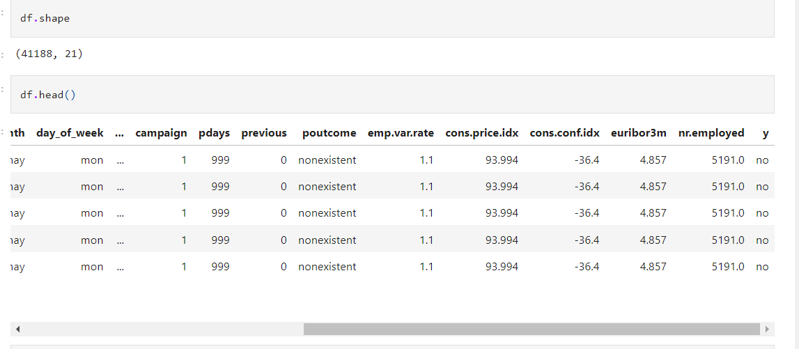
Computing and visualizing KPIs using Python

Slide 19
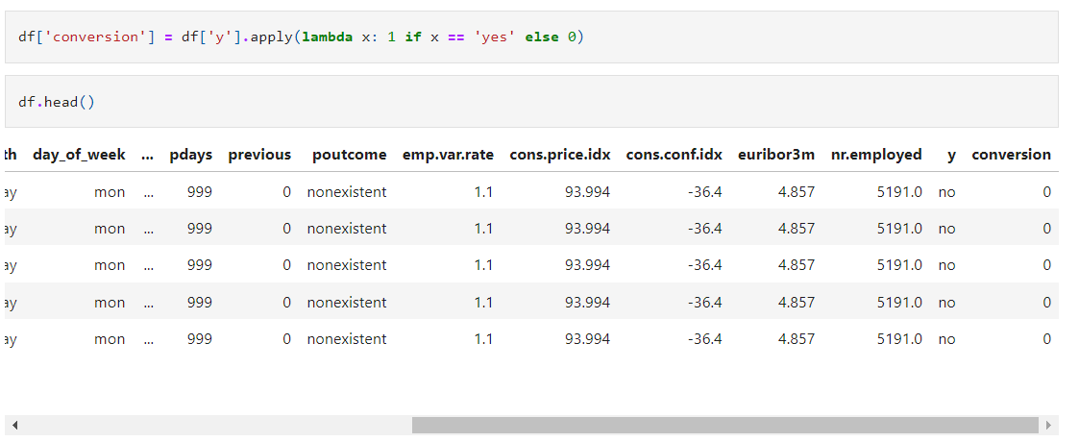
Computing and visualizing KPIs using Python
After execute the following command, a dummy variable has been created with 1 and 0
df['conversion'] = df['y'].apply(lambda x: 1 if x == 'yes' else 0)

Slide 20
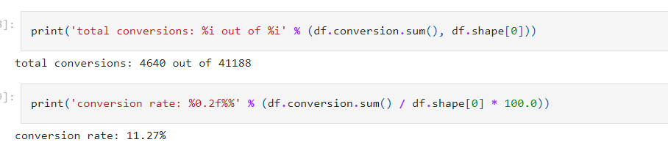
Aggregate conversion rate
To calculate this metric, divide the total number of clients subscribed to a term deposit by the total number of clients in the data.
Use the encoded column named “conversion”
print('total conversions: %i out of %i' % (df.conversion.sum(), df.shape[0]))
print('conversion rate: %0.2f%%' % (df.conversion.sum() / df.shape[0] * 100.0))

Slide 21
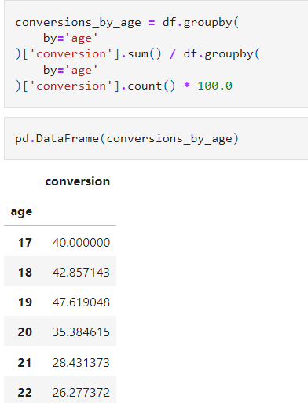
Conversion rates by age
Aggregate conversion rate tells us the overall performance of marketing campaigns.
To find more insights, break down the customer base into multiple segments and compute KPIs for individual segments.
conversions_by_age = df.groupby( by='age')['conversion'].sum() / df.groupby( by='age')['conversion'].count() * 100.0
pd.DataFrame(conversions_by_age)

Slide 22
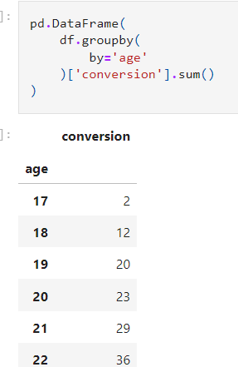
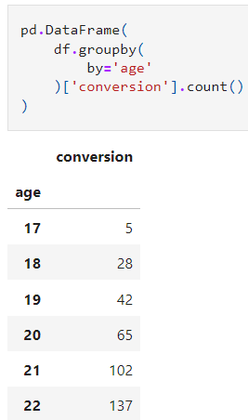
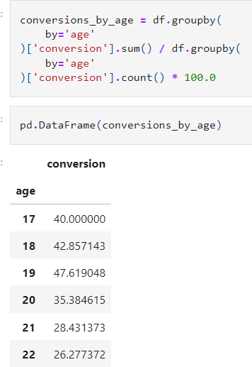
Conversion rates by age

Slide 23
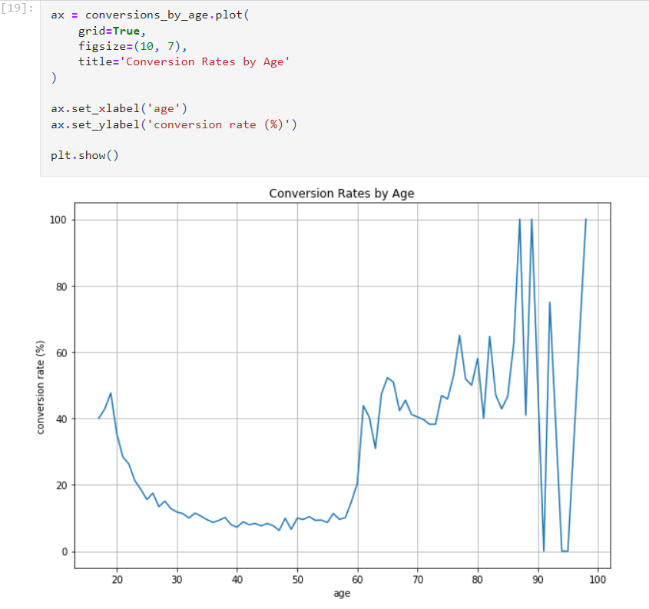

Slide 24
Conversion rates by age
In the previous line chart, there seem to be lots of noise in old age groups.
Conversion rates for those who are 70 or older vary a lot.
Because the number of clients in this age group is relatively small, compared to other age groups.
To reduce this noise, can group multiple ages together.
Group bank clients into 6 groups based on their age- 18-30, 30-40, 40-50, 50-60, 60-70 and >70
df['age_group'] = df['age'].apply(
lambda x: '[18, 30)' if x < 30 else '[30, 40)' if x < 40 \
else '[40, 50)' if x < 50 else '[50, 60)' if x < 60 \
else '[60, 70)' if x < 70 else '70+'
)

Slide 25
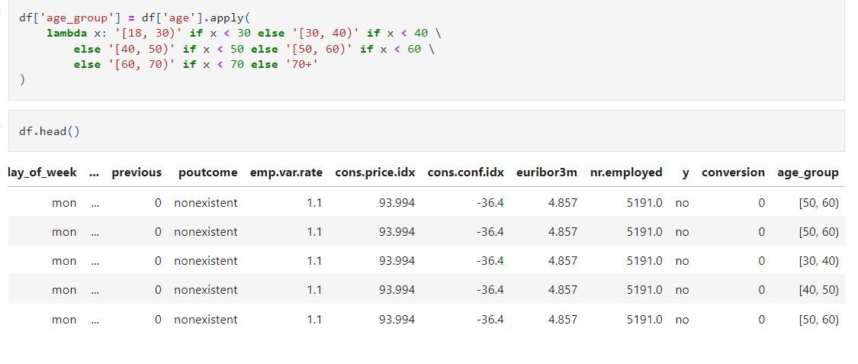
Conversion rates by age

Slide 26
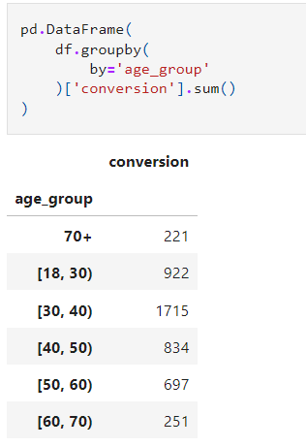
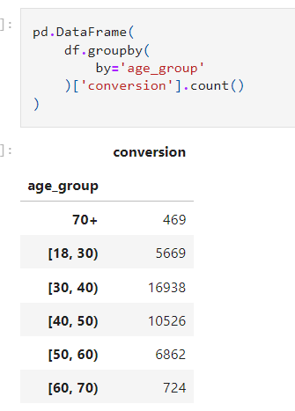
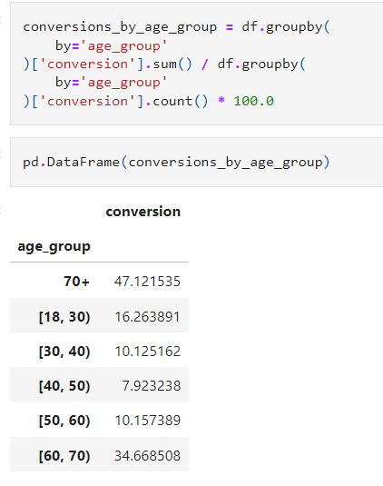
Conversion rates by age

Slide 27
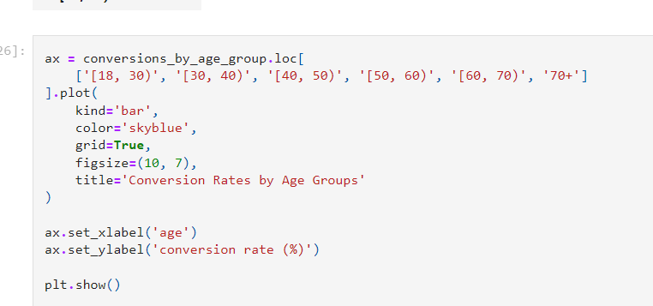
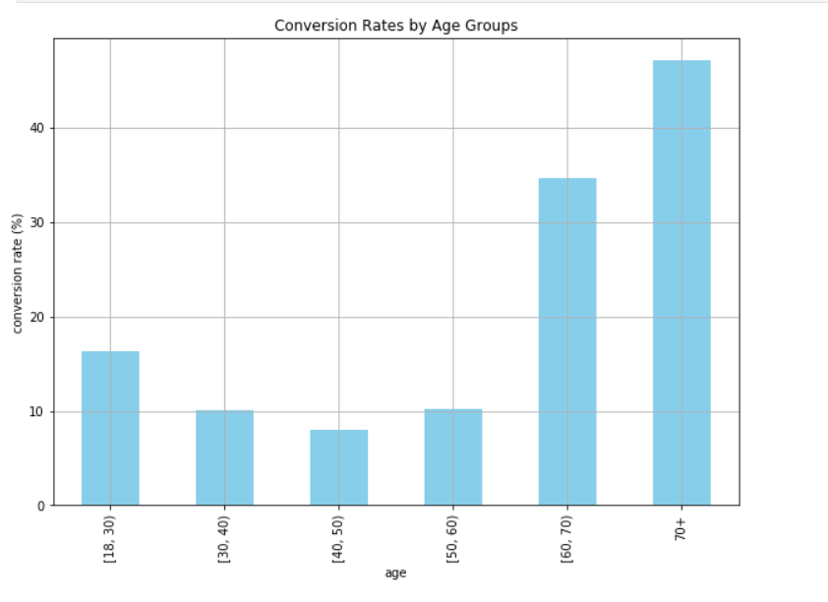
Conversion rates by age

Slide 28
Conversions versus Non-conversions
This type of analysis helps to identify what differentiates converted groups from non-converted groups in our marketing campaigns
Also, help to understand our target clients better and what type of customers respond better to our marketing efforts.
Also compare the distributions of the marital status among the conversions and non-conversions groups.
Use the pivot table function of the pandas package to categorize the data into each group and the resulting data looks as follows.
To visualize, use pie chart- autopct argument to format the label for each group in pie chart.
With pie chart, the married group takes up the largest proportions in both conversions and non-conversions groups, while the single groups come as the second.
With a pie chart, we can easily visualize the similarities and differences between the groups.

Slide 29
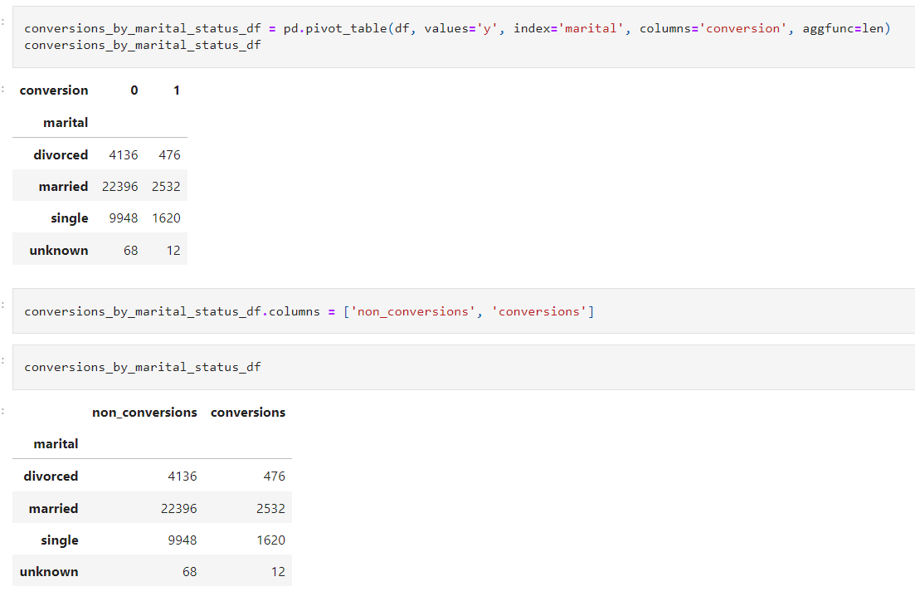

Slide 30
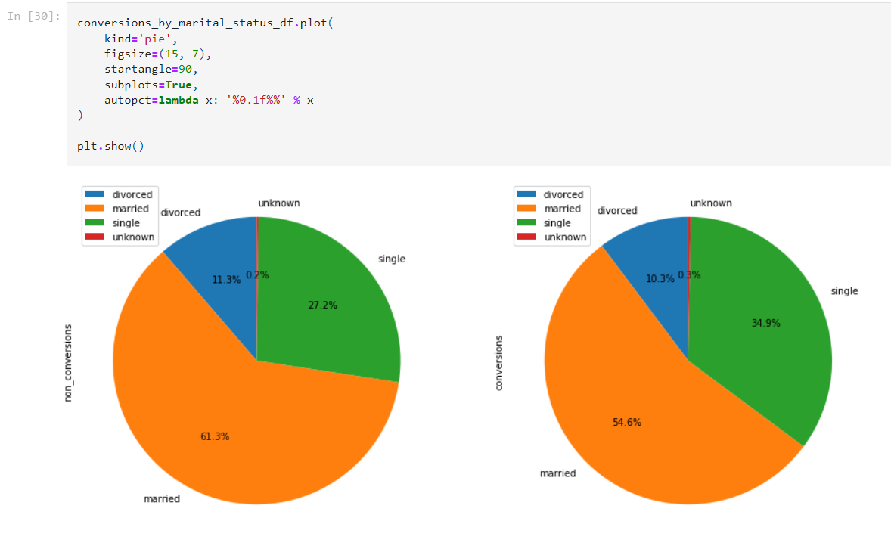

Slide 31
Conversions by age and marital status
So far, aggregated the data by one criterion. Here, group the data by more than one column.
Goup the data by 2 columns age-group and marital and sum the number of conversions
Then divide this by the total number of clients in each group.
age_marital_df = df.groupby(['age_group', 'marital'])['conversion'].sum().unstack('marital').fillna(0)
age_marital_df = age_marital_df.divide(
df.groupby(
by='age_group'
)['conversion'].count(),
axis=0
)
a

Slide 32
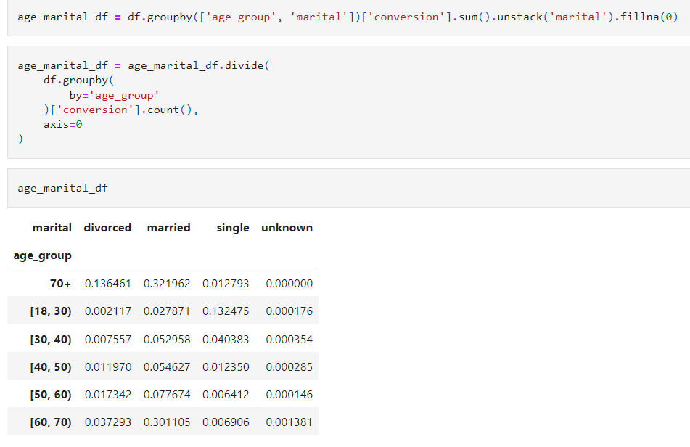

Slide 33
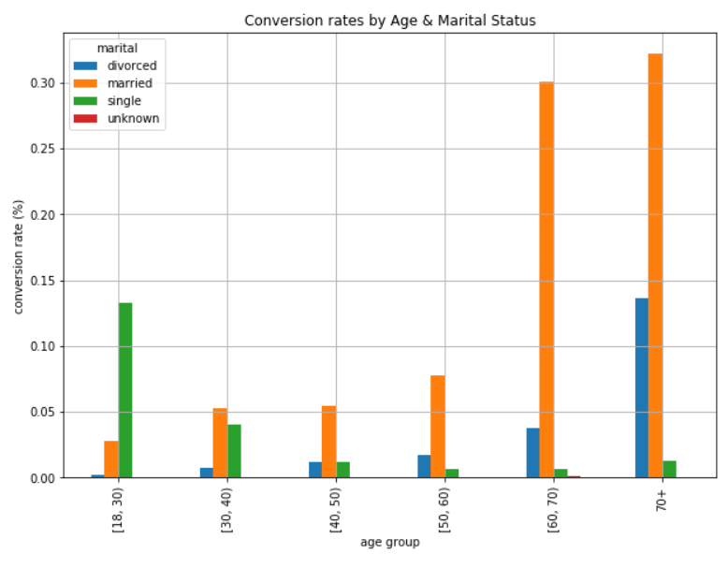
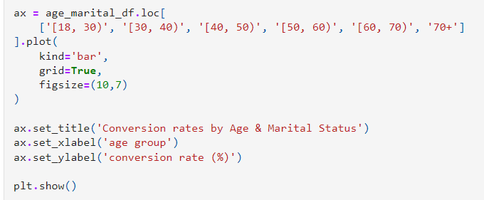
Conversions by age and marital status

Slide 34
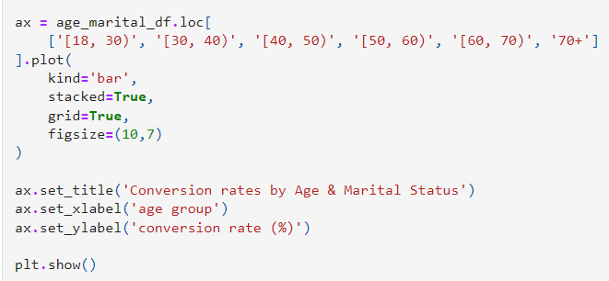
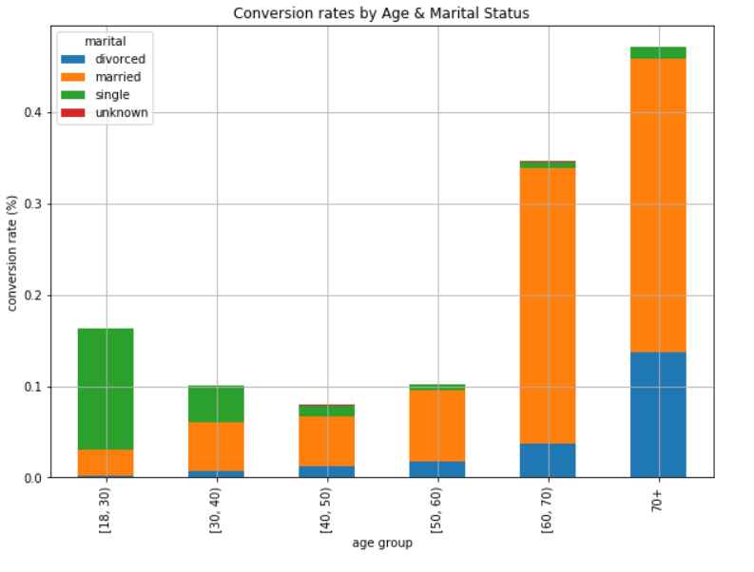
Conversions by age and marital status

Slide 35
Computing and Visualizing KPIs using R
library(dplyr) # Data Wrangling and Manipulation
library(ggplot2)
conversionsDF <- read.csv(
file="~/Documents/data-science-for-marketing/ch.2/data/bank-additional-full.csv",
header=TRUE, sep=";")
# Shape of conversionsDF
dim(conversionsDF)
# Quick look at conversionsDF
head(conversionsDF)

Slide 36
Computing and Visualizing KPIs using R
# Encode conversions as 0s and 1s
conversionsDF$conversion <- as.integer(conversionsDF$y) - 1
tail(conversionsDF)
#### 1. Aggregate Conversion Rate ####
sprintf("total conversions: %i out of %i", sum(conversionsDF$conversion), nrow(conversionsDF))
sprintf("conversion rate: %0.2f%%", sum(conversionsDF$conversion)/nrow(conversionsDF)*100.0)

Slide 37
Computing and Visualizing KPIs using R
# a. by age
conversionsByAge <- conversionsDF %>%
group_by(Age=age) %>%
summarise(TotalCount=n(), NumConversions=sum(conversion)) %>%
mutate(ConversionRate=NumConversions/TotalCount*100.0)
head(conversionsByAge)
# line chart
ggplot(data=conversionsByAge, aes(x=Age, y=ConversionRate)) +
geom_line() + ggtitle('Conversion Rates by Age') +
xlab("Age") + ylab("Conversion Rate (%)") +
theme(plot.title = element_text(hjust = 0.5))

Slide 38
Computing and Visualizing KPIs using R
# b. by age groups
conversionsByAgeGroup <- conversionsDF %>%
group_by(AgeGroup=cut(age, breaks= seq(20, 70, by = 10)) ) %>%
summarise(TotalCount=n(), NumConversions=sum(conversion)) %>%
mutate(ConversionRate=NumConversions/TotalCount*100.0)
conversionsByAgeGroup$AgeGroup <- as.character(conversionsByAgeGroup$AgeGroup)
conversionsByAgeGroup$AgeGroup[6] <- "70+"

Slide 39
Computing and Visualizing KPIs using R
# bar chart
ggplot(conversionsByAgeGroup, aes(x=AgeGroup, y=ConversionRate)) +
geom_bar(width=0.5, stat="identity") +
ggtitle('Conversion Rates by Age Groups') +
xlab("Age") +
ylab("Conversion Rate (%)") +
theme(plot.title = element_text(hjust = 0.5))

Slide 40
Computing and Visualizing KPIs using R
#### 4. Conversions vs. Non-Conversions ####
# 4.1. Marital Status
conversionsByMaritalStatus <- conversionsDF %>%
group_by(Marital=marital, Conversion=conversion) %>%
summarise(Count=n())
conversionsByMaritalStatus

Slide 41
Computing and Visualizing KPIs using R
# pie chart
ggplot(conversionsByMaritalStatus, aes(x="", y=Count, fill=Marital)) +
geom_bar(width=1, stat = "identity", position=position_fill()) +
geom_text(aes(x=1.25, label=Count), position=position_fill(vjust = 0.5)) +
coord_polar("y") +
facet_wrap(~Conversion) +
ggtitle('Marital Status (0: Non Conversions, 1: Conversions)') +
theme(
axis.title.x=element_blank(), axis.title.y=element_blank(),
plot.title=element_text(hjust=0.5),
legend.position='bottom'
)

Slide 42
Computing and Visualizing KPIs using R
#### 5. Conversions by Age Groups & Marital Status ####
conversionsByAgeMarital <- conversionsDF %>%
group_by(AgeGroup=cut(age, breaks= seq(20, 70, by = 10)), Marital=marital) %>%
summarise(Count=n(), NumConversions=sum(conversion)) %>%
mutate(TotalCount=sum(Count)) %>%
mutate(ConversionRate=NumConversions/TotalCount)
conversionsByAgeMarital$AgeGroup <- as.character(conversionsByAgeMarital$AgeGroup)
conversionsByAgeMarital$AgeGroup[is.na(conversionsByAgeMarital$AgeGroup)] <- "70+"

Slide 43
Computing and Visualizing KPIs using R
# bar chart
ggplot(conversionsByAgeMarital, aes(x=AgeGroup, y=ConversionRate, fill=Marital)) +
geom_bar(width=0.5, stat="identity", position="dodge") +
ylab("Conversion Rate (%)") +
xlab("Age") +
ggtitle("Conversion Rates by Age and Marital Status") +
theme(plot.title=element_text(hjust=0.5))

Slide 44
Computing and Visualizing KPIs using R
# stacked bar chart
ggplot(conversionsByAgeMarital, aes(x=AgeGroup, y=ConversionRate, fill=Marital)) +
geom_bar(width=0.5, stat="identity", position="stack") +
ylab("Conversion Rate (%)") +
xlab("Age") +
ggtitle("Conversion Rates by Age and Marital Status") +
theme(plot.title=element_text(hjust=0.5))

